Slide 1
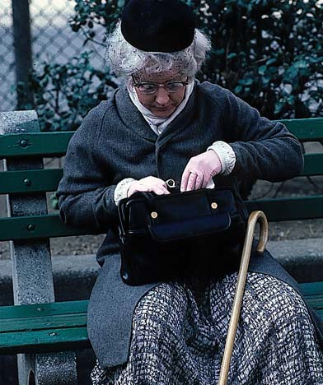
Learning About People CSCI 5839 Fall 2014 Shaun Kane

Slide 2
Activity
Work with your project group
Come up with bad questions and fix them
We’ll start with interview questions
Sign + take a picture of your notes
Upload to Piazza (or turn in the paper one and email to peers)

Slide 3
Let’s discuss questions

Slide 4

More on question design
Duke, Instrument Design and Development http://dism.ssri.duke.edu/question_design.php
SurveyMonkey, Improving Online Surveys https://www.surveymonkey.com/blog/en/blog/2012/04/13/10-online-survey-tips/

Slide 5
Upcoming deadlines
Today
T0: Collaboration plan and blog
Tuesday:
A3: Observation and notes
T1 (project research) pushed back to 10/2
But start planningnow

Slide 6
Today
Other (mostly) qualitative research methods
With pointers to learn more about them
T1 (due in two weeks)
Pick two research methods
Conduct research with at least 4 representative users
Details on web site

Slide 7
Other data collection methods
Focus groups
Participant observation / ethnography
Contextual design
Diary study
Experience sampling
Cultural probe

Slide 8
Focus groups
Create a “design team”
Empower participants to engage with creative ideas
Find commonalities, trigger memories of focus group members
“Oh yeah, I’ve had that experience too…”
Can be more time efficient than interviews (but usually isn’t)

Slide 9
Why focus groups are hard
One person dominates conversation
Shy participants hesitant to engage
Run out of things to talk about

Slide 10
Why focus groups are hard
One person dominates conversation
Shy participants hesitant to engage
Run out of things to talk about
Turn taking, sub-teams, ask focused questions to everyone
Structured meetings (“today we’ll talk about riding the bus”)

Slide 11
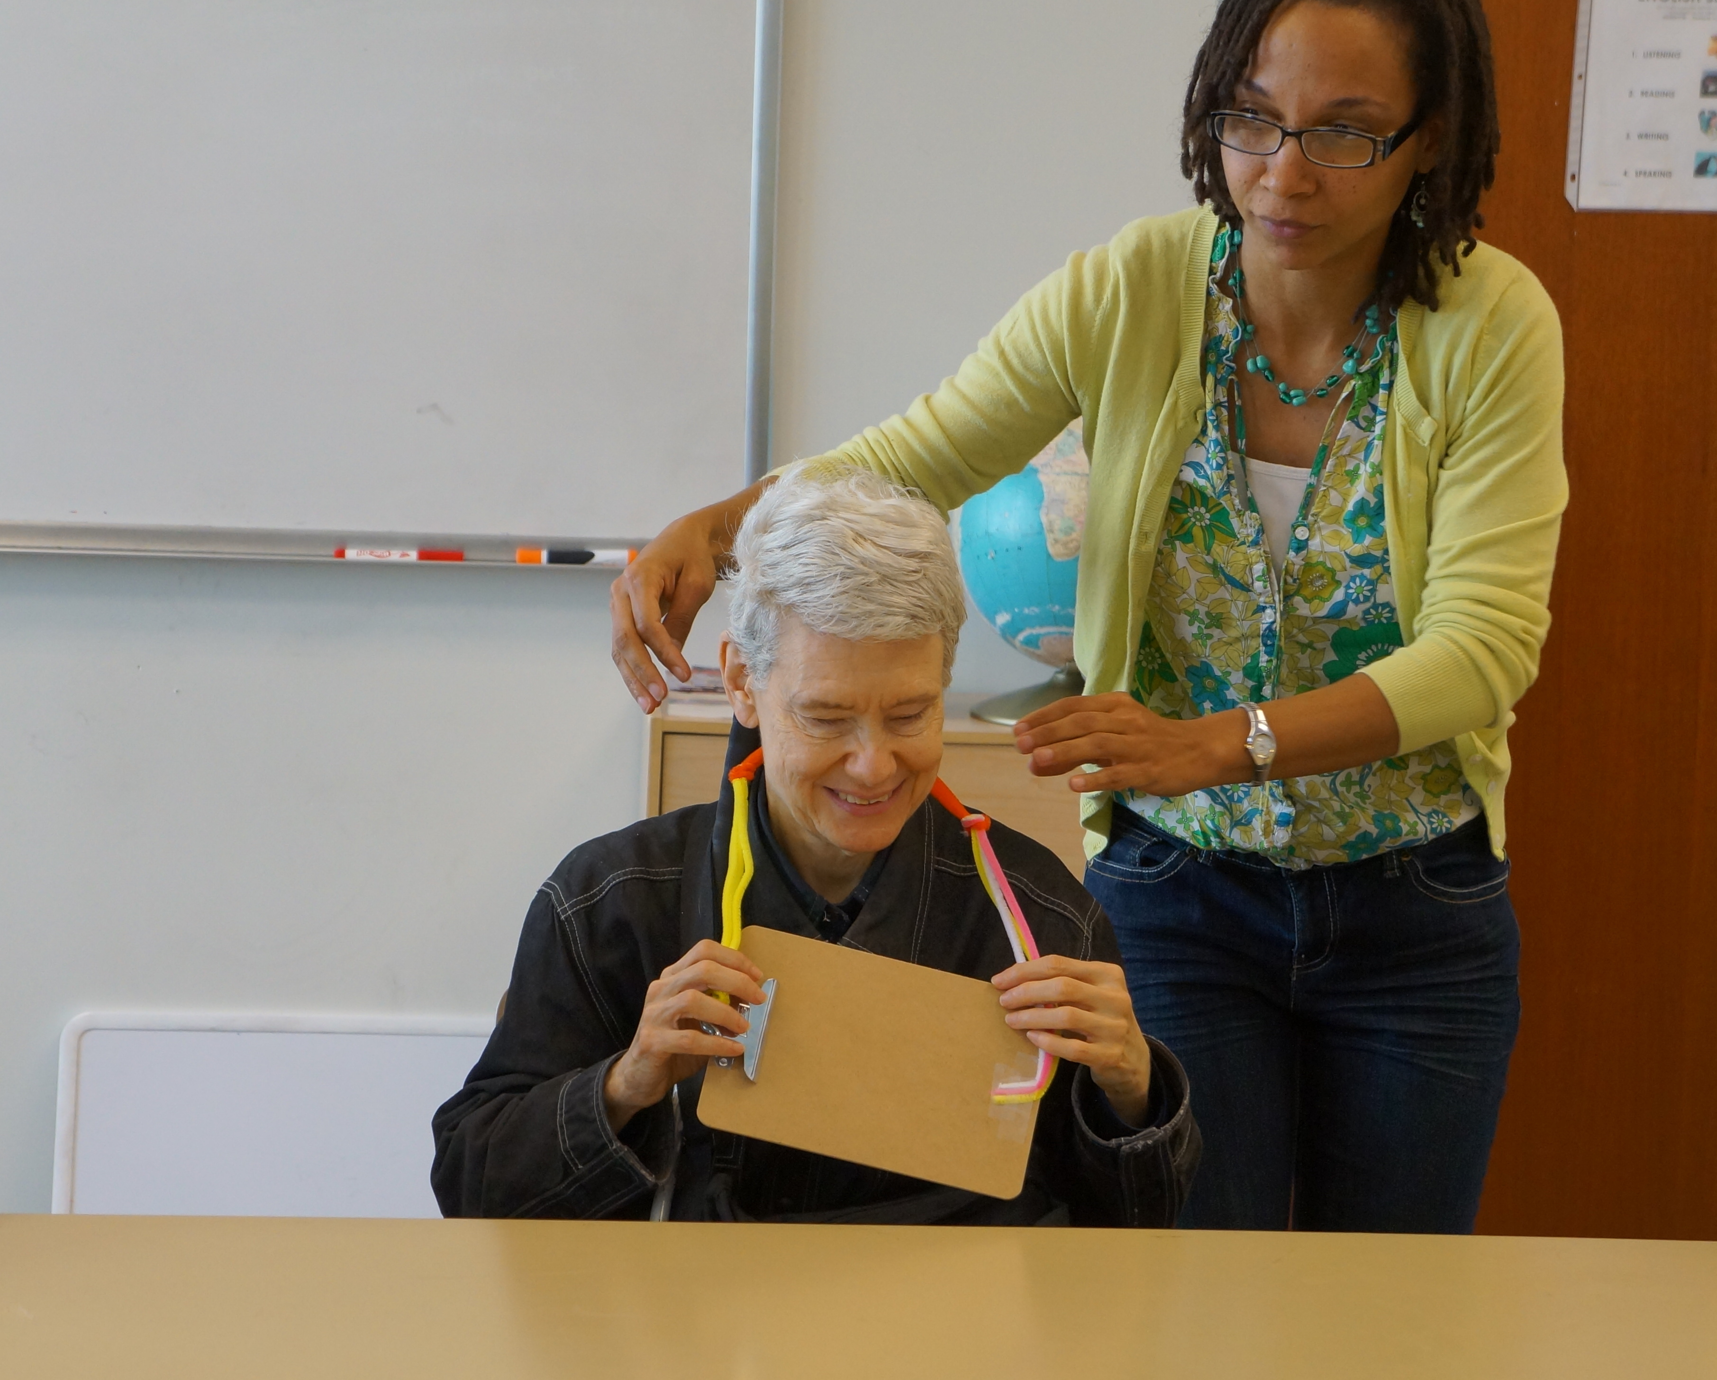
For more information: Kitzinger, J. (1995). Qualitative research: introducing focus groups. BMJ, 311(7000), 299-302.
http://www.ncbi.nlm.nih.gov/pmc/articles/PMC2550365/pdf/bmj00603-0031.pdf

Slide 12
Ethnography (“culture writing”)
Primary technique from cultural anthropology
Traditional science focuses on objectivity
Understanding from the “outside”
Ethnography focuses on understanding the subject as s/he understands her/himself
Participant observation – not just observing other participants, but acting as a participant

Slide 13
Ethnography
+ Get out of the lab
+ Gain deep experience of a specific culture
+ Approach understanding from inside
– Extremely time consuming (months, years)
– Demanding on participants
– Data focuses on one person’s experience

Slide 14
More about ethnography
Reference
Dourish, P. Reading and Interpreting Ethnography. In Olson, J. S., & Kellogg, W. A. (2014). Ways of Knowing in HCI. (free ebook via CU Library)
Examples
Nathan, L. P. (2012). Sustainable information practice: An ethnographic investigation. Journal of the American Society for Information Science and Technology, 63(11), 2254-2268.
boyd, d. m. 2004. Friendster and publicly articulated social networking. In CHI EA '04. ACM, New York, NY, USA, 1279-1282. http://doi.acm.org/10.1145/985921.986043

Slide 15
Using ethnography
In most cases, HCI researchers or designers don’t perform ethnography at a respectable level (for anthropologists)
“Rapid ethnography” (Millen) and other “quick and dirty ethnography” methods are inspired by ethnography, but lack the complete richness of ethnography

Slide 16
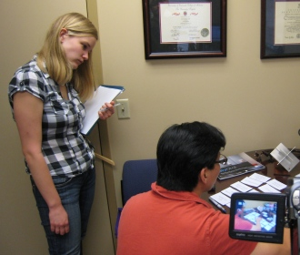
Contextual Design/Inquiry
“The core premise of Contextual Inquiry is very simple: go where the customer works, observe the customer as he or she works, and talk to the customer about the work.” —Contextual Design (Beyer and Holtzblatt, p. 41)

Slide 17
Contextual inquiry
Observational interview method
Shadow participants, ask questions about what’s happening (and work history)
Inspired by ethnographic methods, but focused on workplaces
Understand users’ environment, task, working groups and culture (expectations, norms, policies, values, etc.)

Slide 18
Example Contextual Questions
What is important to the user?
How, why are certain choices made?
How does the user think about their needs and goals?
How does the user understand the system?
Note: user may not always understand her/himself, so we study the understanding, and study her/him objectively (in context).

Slide 19
Diary study
Ask participants to record their experiences over a period of time (usually some number of days)
Ask them to consider specific issues or problems; may involve writing prompts
Data collection methods: paper, web form, voice mail

Slide 20
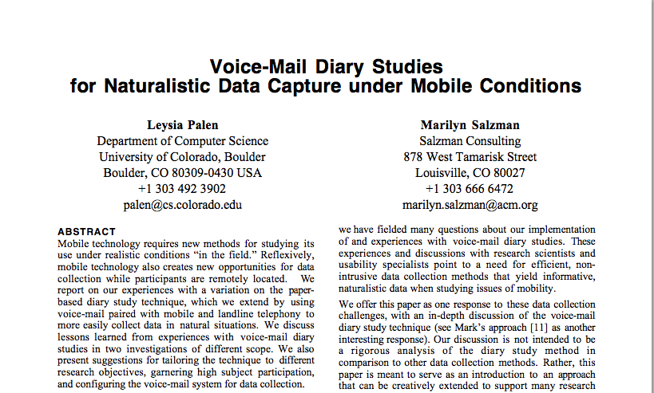
Palen, L., & Salzman, M. (2002, November). Voice-mail diary studies for naturalistic data capture under mobile conditions. In Proceedings of the 2002 ACM conference on Computer supported cooperative work (pp. 87-95). ACM. http://pdf.aminer.org/000/121/935/voice_mail_diary_studies_for_naturalistic_data_capture_under_mobile.pdf

Slide 21
Diary study
+ Capture experiences that may not come up in an interview
+ Identify changes over time
– Can be time consuming
– Participant may forget (or need incentives)

Slide 22
Experience sampling
How do you capture data at the moment something is happening?
Experience sampling: deliver questions to participants while they are performing the task you want to know about
e.g. call someone at work and ask how busy they are
Requires extensive planning (or technology)

Slide 23
Experience sampling
Consolvo, S., & Walker, M. (2003). Using the experience sampling method to evaluate ubicomp applications. IEEE Pervasive Computing, 2(2), 24-31. http://www.intel-research.net/Publications/Seattle/final-ESM-pub-with-Walker.pdf
Froehlich, J., Chen, M. Y., Consolvo, S., Harrison, B., & Landay, J. A. (2007, June). MyExperience: a system for in situ tracing and capturing of user feedback on mobile phones. In Proceedings of the 5th international conference on Mobile systems, applications and services (pp. 57-70). ACM. http://static.usenix.org/legacy/events/mobisys07/full_papers/p57.pdf

Slide 24
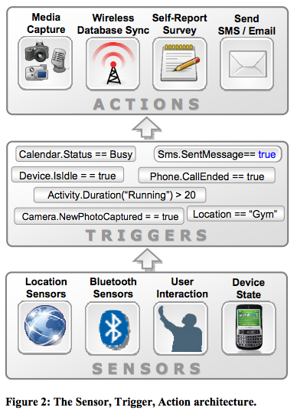
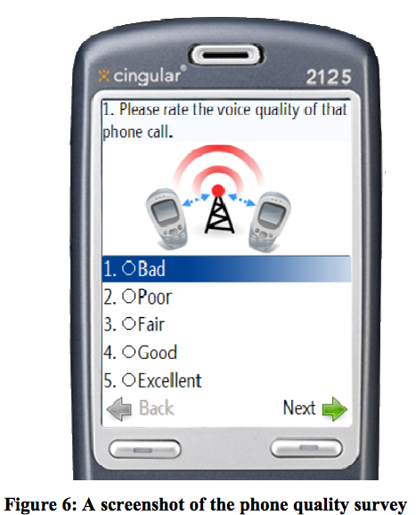

Slide 25
Cultural probes
A way to gather more about individuals’ lived experience
Can be a kind of extended diary study
Create structured activities in which participants gather data about their own experiences

Slide 26
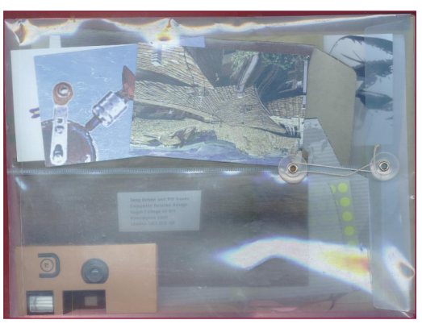
The cultural probe package

Slide 27
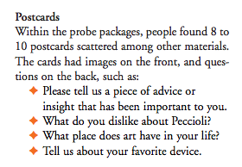
The cultural probe package

Slide 28
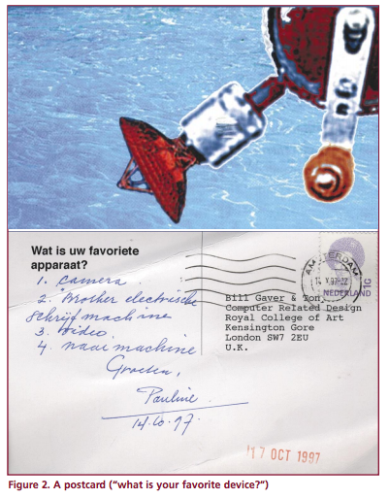
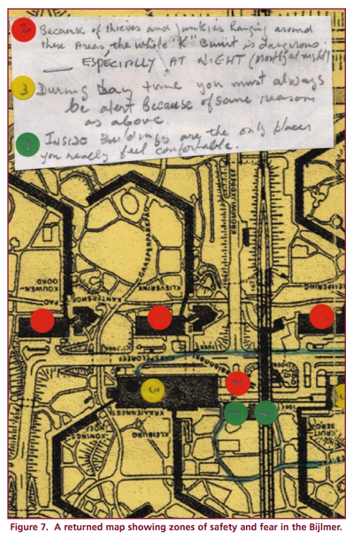

Slide 29
Cultural probes
+ Rich, interesting data
+ Engaging for participants
– May be difficult to draw conclusions
Gaver, B., Dunne, T., & Pacenti, E. (1999). Design: cultural probes. interactions, 6(1), 21-29.
https://www.youtube.com/watch?v=EJqpUG4pJIE

Slide 30
Tips on data collection
Collecting data is a full time job
Taking good notes is another
So get help if you can
Triangulate among multiple sources
Be prepared to go back and collect more data

Slide 31
Analysis

Slide 32
Analysis
Collect data
Field notes
Recorded audio (transcribe!)
Participant-completed documents (questionnaires etc.)
Photographs or video
Be sure to remove identifying information; use aliases

Slide 33

Identifying themes
You’ll inevitably end up with a bunch of data about different kinds of things
How to identify trends or themes?
Notes:
http://amormagazine.co.uk/wp-content/uploads/2014/09/post.jpg

Slide 34
Affinity diagramming
Enumerate all of the ideas that you have; write each on a Post-It
Put post-its on the wall
Arrange into logical groups
Label the groups
Similar to card sorting

Slide 35
Let’s try it
5 minutes: generate as many ideas as you can about why solving your project problem is difficult
5 minutes: arrange in groups. What are the themes?

Slide 36
Next time
Representing participants via personas and scenarios

